Slide 1


Introduction to Biostatistics and R
SUIP Biostatistics Workshop
Tuesday, June 6, 2023
Session 1

Slide 2
Structure of Workshops
Session 1: Tuesday, June 6
Introduction to biostatistics and R, a free language for statistical computing
Session 2: Wednesday, June 7
Introduce descriptive statistics (e.g., proportions, means) and tools for statistical inference (e.g., estimation, confidence intervals, and hypothesis testing) and show how to implement in R
Session 3: Thursday, June 8
Introduction to regression models (e.g., linear regression) and how to implement in R
Please feel free to ask questions as we go!

Slide 3

My Background
Nina Alfaro, MS (alfarom@pennmedicine.upenn.edu)
BA in Chemistry with minors in Mathematics, Biology, and Spanish
MS in Health Informatics
1st year student within the Biostatistics program in the Graduate Group in Epidemiology and Biostatistics (GGEB)
Research Interests:
Clinical Trials
Behavioral Economics
Wearables and Gaming Technology

Slide 4
Let’s get started!
Introduction to Biostatistics

Slide 5
Outline for Today’s Workshop
Basic principles of statistics
Emphasize the importance of learning statistics
Introduction to R and RStudio
Saving scripts
Basic Commands
Working with and saving variables
Data frames
The R Environment

Slide 6
Outline for Today’s Workshop
Basic principles of statistics
Emphasize the importance of learning statistics
Introduction to R and RStudio
Saving scripts
Basic Commands
Working with and saving variables
Data frames
The R Environment
Key focus of today!

Slide 7
Outline for Today’s Workshop
Basic principles of statistics
Emphasize the importance of learning statistics
Introduction to R and RStudio
Saving scripts
Basic Commands
Working with and saving variables
Data frames
The R Environment
Important to understand basics of R before learning basic statistical methods and how to implement them using R code!
Key focus of today!

Slide 8
Statistics
Statistics is the science concerned with developing and studying methods for collecting, analyzing, interpreting and presenting empirical data.
Uses data from a sample to make inferences about a population.
Biostatistics
The application of statistics to a wide range of topics in medical research, including clinical trials, epidemiology, pharmacology, cost effectiveness research, genetics, neuroimaging, etc.

Slide 9
Basic Principles of Statistics
Present a valid research question
Design a valid study and collect information (data) that can answer the question
Clean and prepare the data for analysis
Analyze the data using appropriate statistical methods
Interpret results from statistical tests and reach conclusions
Communicate results

Slide 10
Basic Principles of Statistics
Present a valid research question
Design a valid study and collect information (data) that can answer the question
Clean and prepare the data for analysis
Analyze the data using appropriate statistical methods
Interpret results from statistical tests and reach conclusions
Communicate results
These are the focus of this 3-part workshop!

Slide 11
Why learn statistics & biostatistics:
For properly conducting your own research
Evaluate others’ research
Many statistical design flaws and errors are still found in the medical literature, including in:
Design and execution
Analysis
Presentation
Interpretation
Omission

Slide 12
Getting started with R
R is a statistical programming language
It’s free!
Great at handling and storing data
Contains many great functions and tools for data analysis
Excellent graphical facilities
Many standard operators and functions for performing quick calculations and statistical analyses
RStudio is a front end to R
Intends to provide same user experience, regardless of your machine
This is what we will use for our workshop series

Slide 13
An Introduction to R
Getting Started

Slide 14
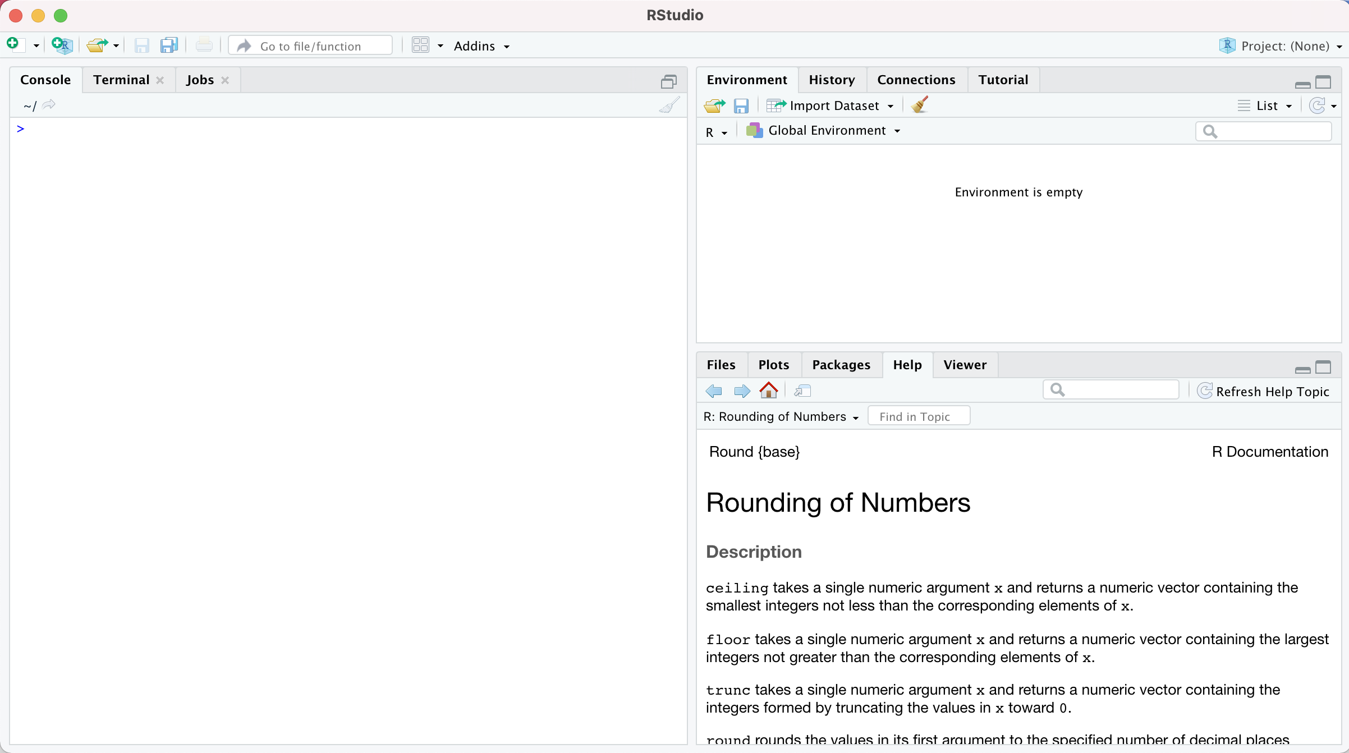
Rstudio is divided into several panels

Slide 15
Minimizing and maximizing panels:

Slide 16
Switching between panels:

Slide 17
Our real interest is the “console”... that’s where we’ll run R code

Slide 18
What is an R script?
They are a great tool for storing the commands for your analyses
They are text files and have a .R extension
They contain a sequence of commands that R will execute when the the script is “sourced” (i.e., run)

Slide 19
How do I use scripts?
Type (or paste) R commands into the text file
Save the script (usually in the same folder as the data)
Use the “source” button to run it

Slide 20
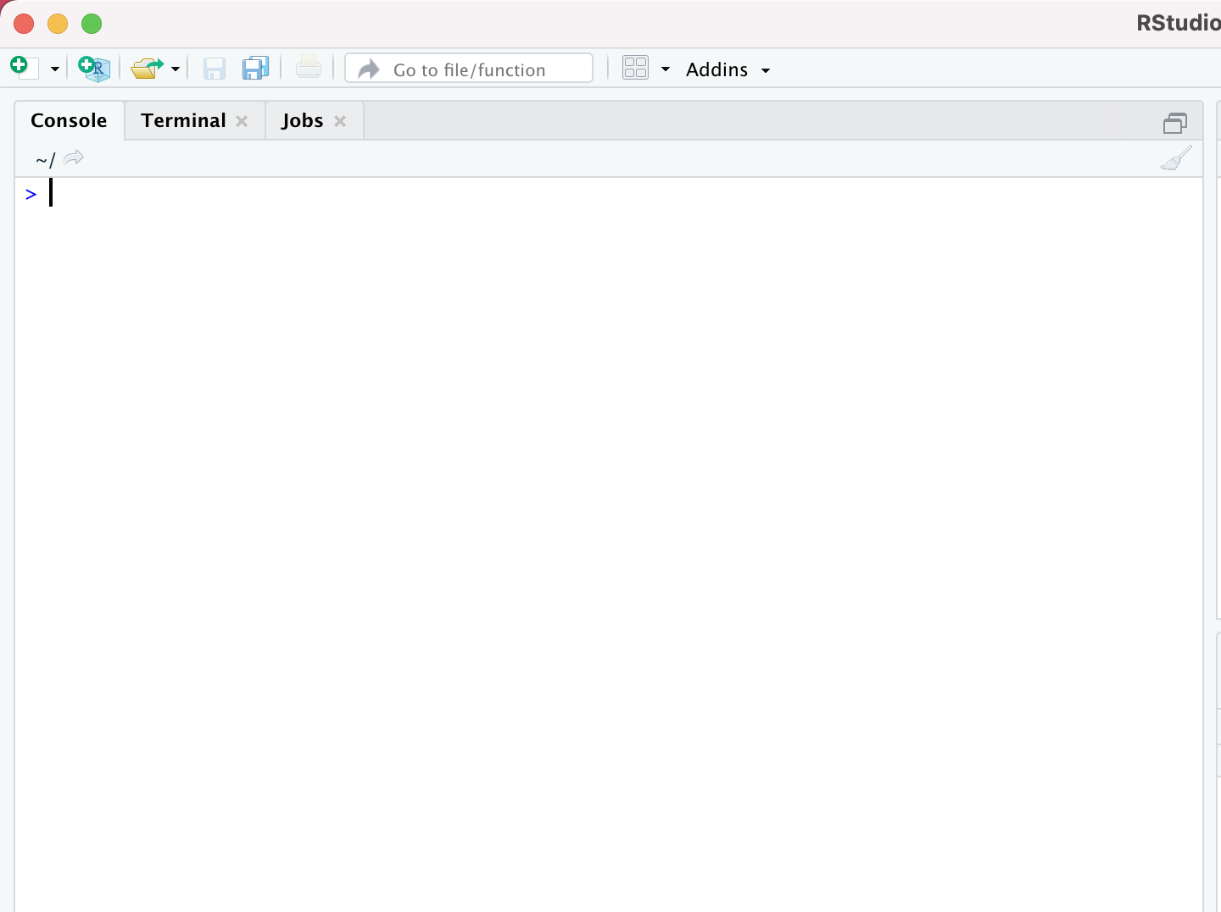
Open an existing script?

Slide 21
Create a new script...

Slide 22
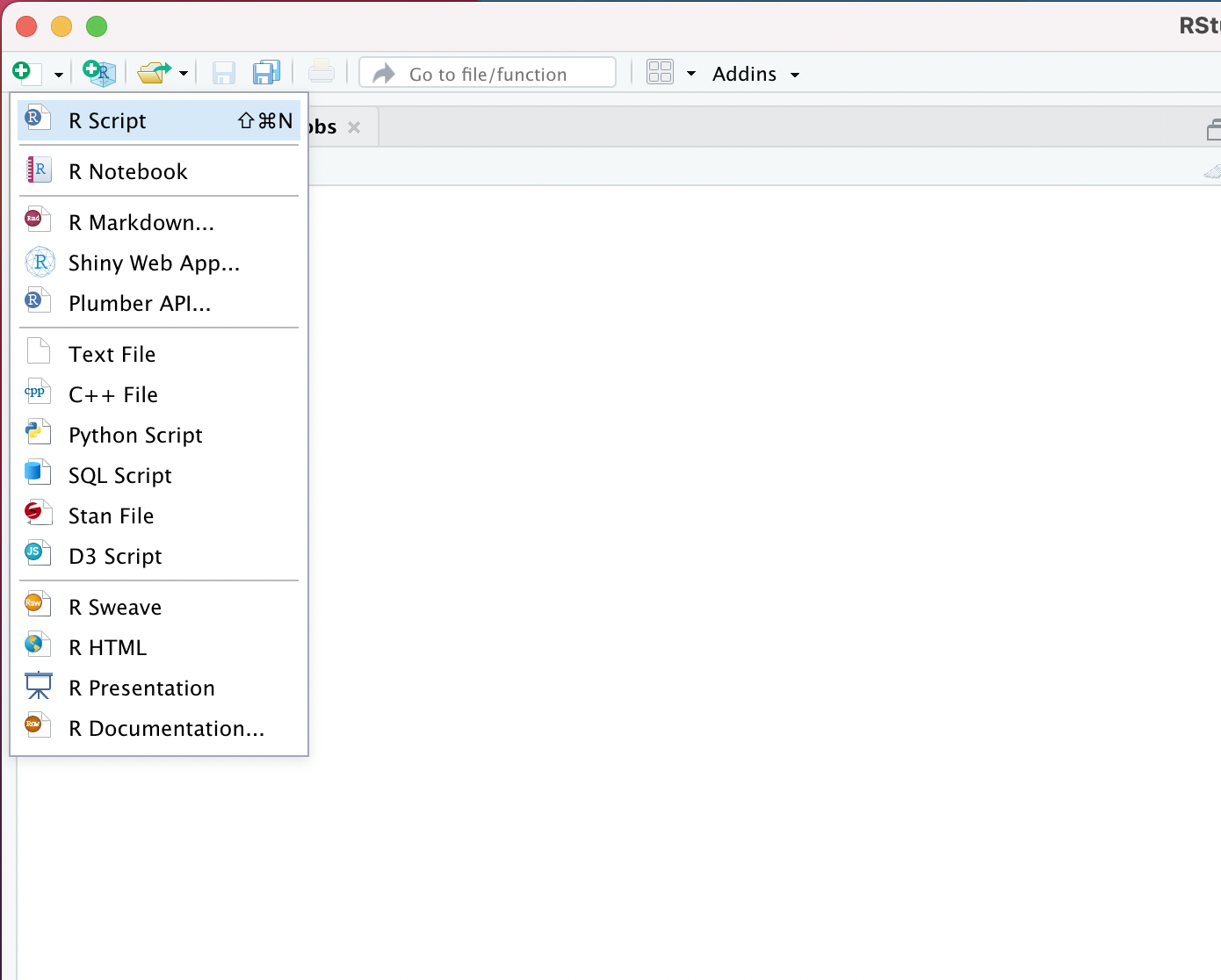
Create a new script...
And here

Slide 23
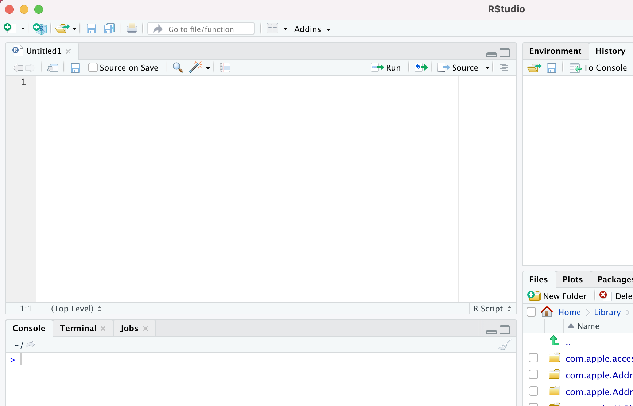
Here’s the new (empty) script

Slide 24
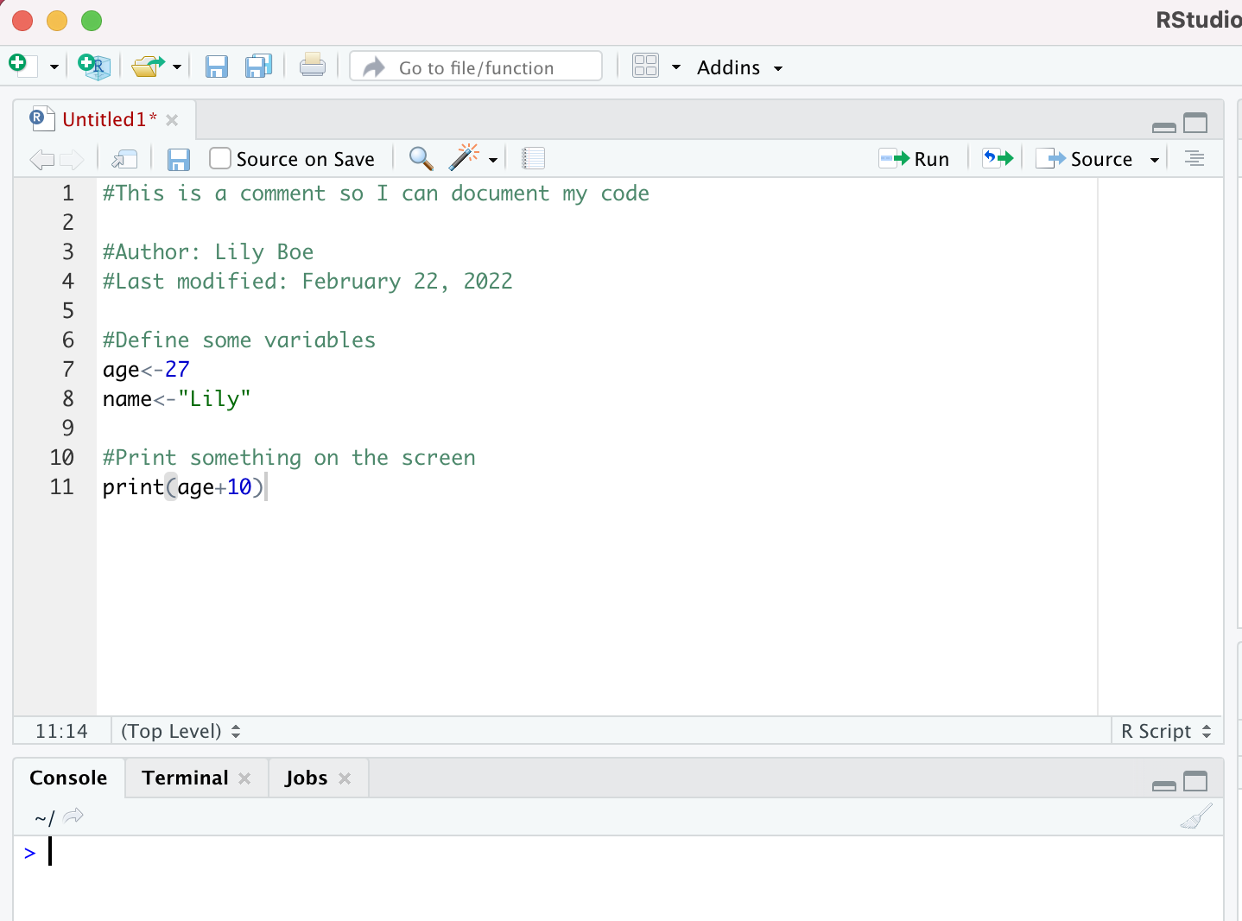
Try it: Type some R commands into the script
Notes:
What has changed?

Slide 25
Type some R commands into the script:
This tells you that the script has some unsaved changes

Slide 26
Type some R commands into the script:
These comments won’t “do” anything, but it’s a good idea to write extensive comments

Slide 27
Type some R commands into the script:
These are the actual R commands that will do something!

Slide 28
We should probably save the script!

Slide 29
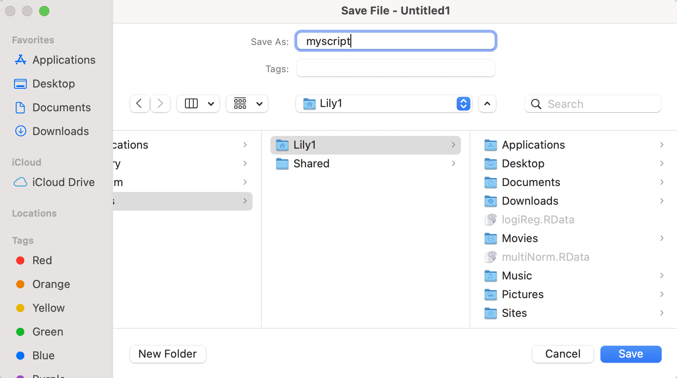
Save it as something like “myscript.R”...

Slide 30
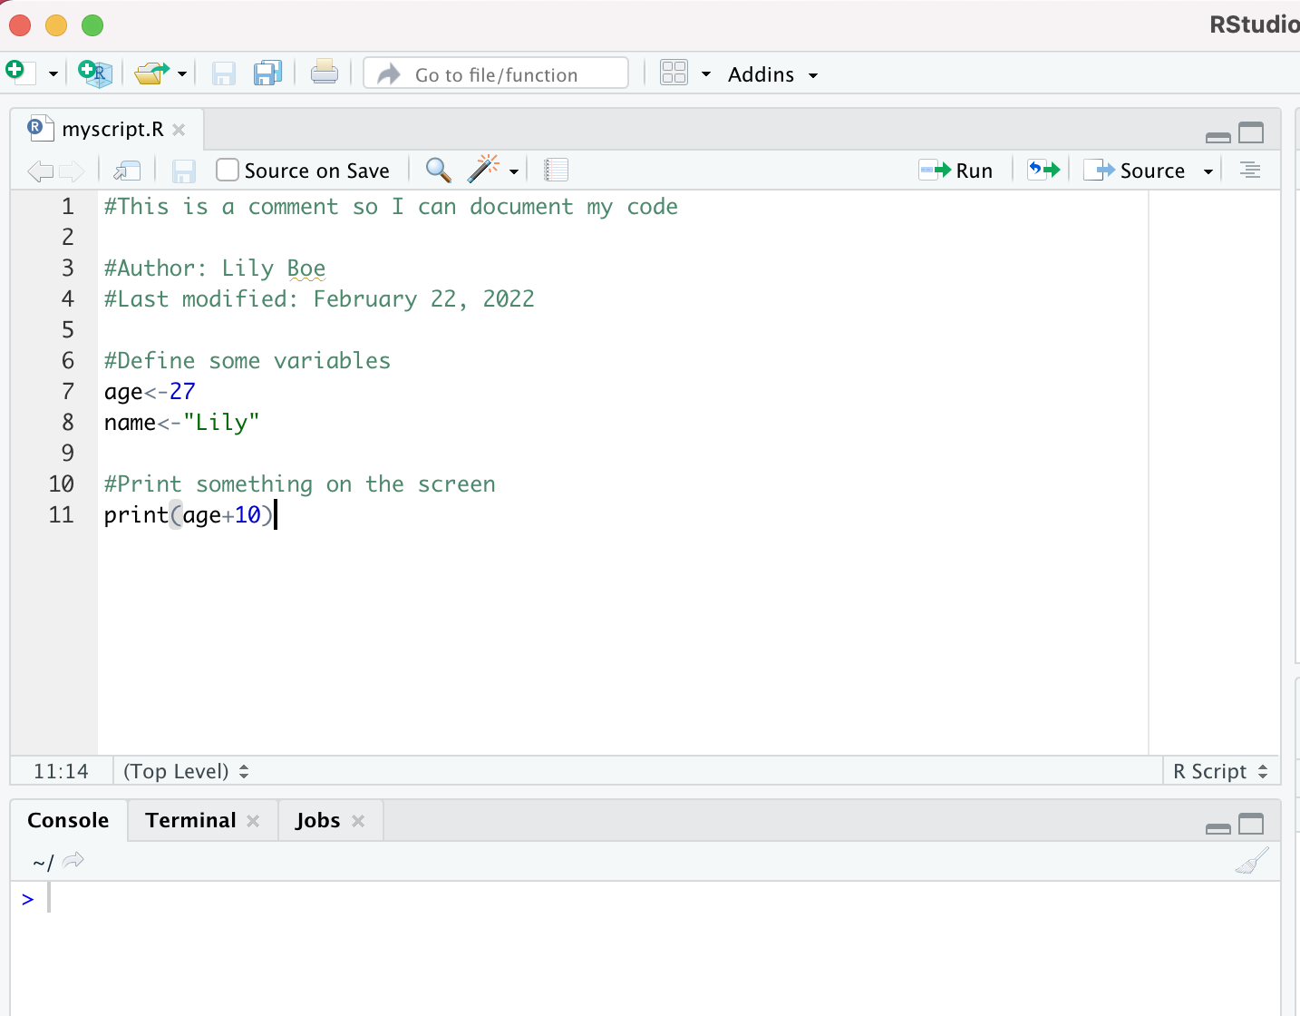
Now to run the script...

Slide 31
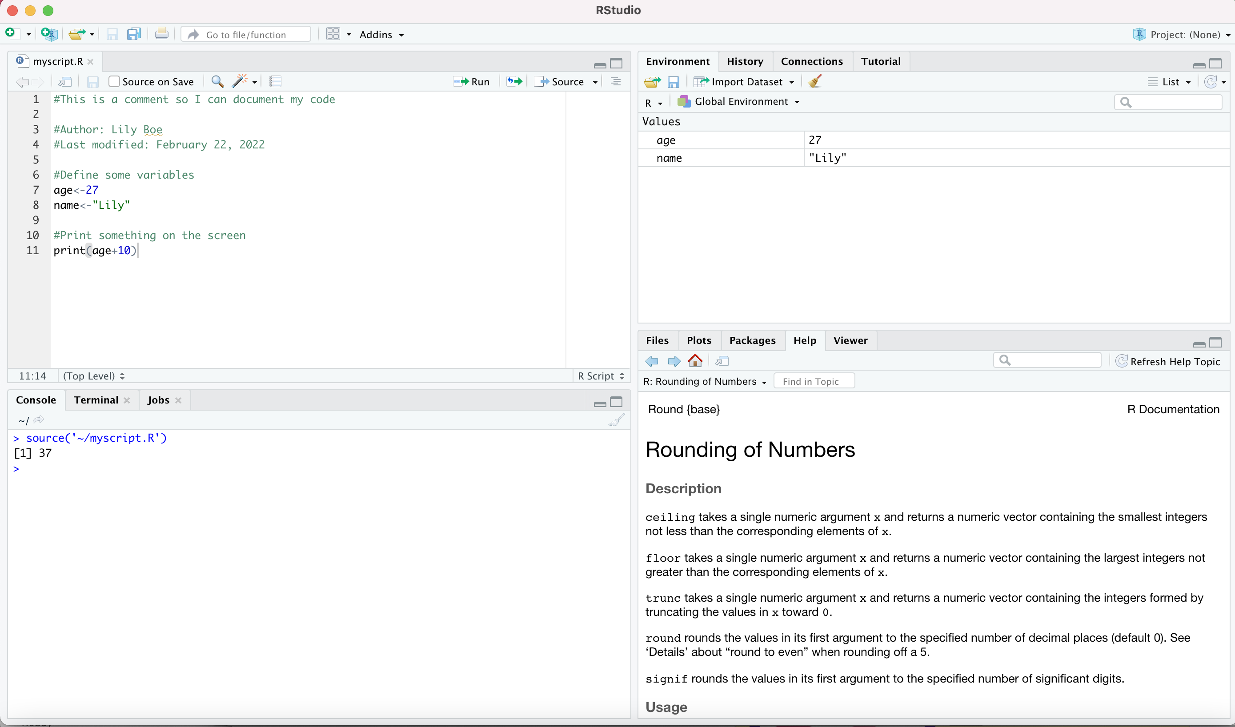

Slide 32
This is the R command that actually ran the script...

Slide 33
These two lines were executed first...

Slide 34
These two lines were executed first... and they created two variables

Slide 35
This line comes next...

Slide 36
And produced this output

Slide 37
Typical workflow
•
•
•
Load data from CSV or Rdata file Play around with some analyses Copy some commands to a script
•
Copy/paste helps, as does the “history” tab in Rstudio Often have separate scripts for different jobs
•
•
•
Save the script(s)
Save the variables created (and the raw data) to new Rdata file(s)

Slide 38
Try it yourself:
Exercise 1.1.1: Writing a script
Use the RStudio toolbars to open a new script
Use the save button to save it to disk (call it something like newscript.R)
Write some comments at the top of the script indicating what the script is for (e.g., “this is for a class exercise”), who wrote it (you), and when it was last modified (today). This is a good habit to get into.
Then add some R commands. Any old commands will do.
Save it again
Click on the “source” button to run the script.

Slide 39

The Working Directory

Slide 40
The working directory
•
What is the “working directory”?
•
•
Because R interacts with files on your computer, it “thinks” of itself as working “in” a particular location.
Anytime you try to open a file without specifying a folder, R will look in the working directory.
> getwd()
[1] "/Users/Lily1"

Slide 41
Getting around the computer
•
R commands
•
•
getwd(), setwd() etc powerful but tedious to use
•
Rstudio is cleaner
•
•
Use the file panel to navigate graphically
“set as working directory” option is equivalent to the R command setwd()

Slide 42
Try it yourself:
Exercise 1.1.2: Identify your working directory
Try running getwd() to identify your working directory on your local computer
If you import Rdata or a csv file dataset, you’ll want to make sure it’s saved in your working directory OR set a new working directory

Slide 43

Basic Commands

Slide 44
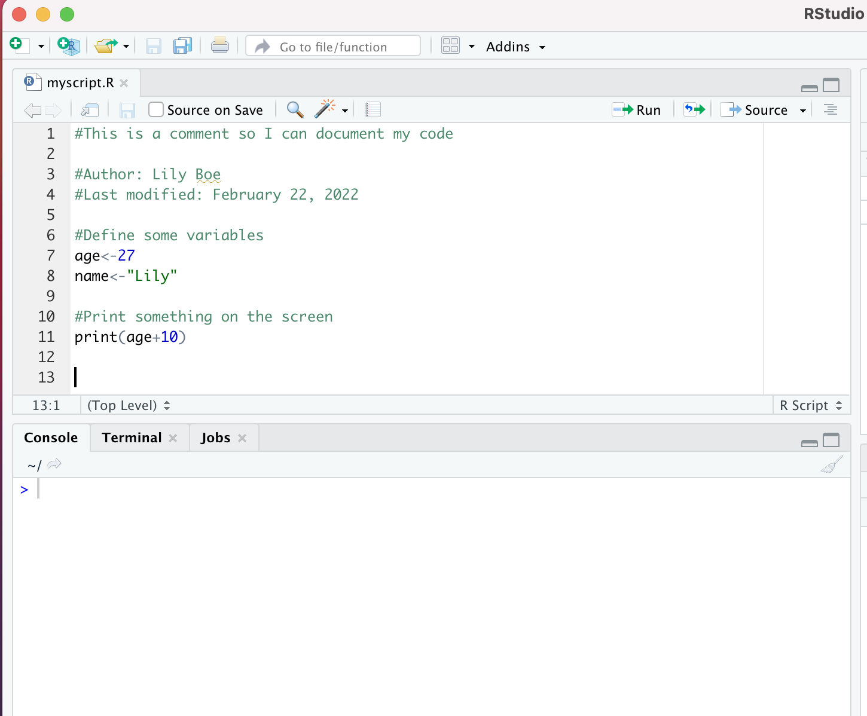
R is an interactive system
You type your commands here...
.... when you hit enter, R immediately executes the command and displays the results on screen.

Slide 45
Our first command...
The > is the command prompt
>
Notes:
What happens if there is a [+] sign?

Slide 46
Our first command...
This is a command
> 10 + 3

Slide 47
Our first command...
> 10 + 3
[1] 13
The number 13 is the output (don’t worry about the [1] for now)

Slide 48
Simple calculations
+ addition
- subtraction
* multiplication
/ division
^ taking powers
These are referred to as “operators” (each operator is used to carry out
a particular kind of operation)

Slide 49
Simple calculations
+ addition
- subtraction
* multiplication
/ division
^ taking powers
These are referred to as “operators” (each operator is used to carry out
a particular kind of operation)
> (6 - 4) / 2
[1] 1
When performing multiple calculations you can use parentheses to make sure R
performs the calculations in the desired order
> 6 - (4/2) [1] 4
(Note: Without parentheses, the order is: ^ first, then * and / second (left to right), and then + and - last (left to right). No-one remembers this at first.)

Slide 50
Try it yourself:
Exercise 1.1.3: Addition
The first command is simple addition, so the exercise is to add some numbers together. Open up R, and use it to do a few basic sums. In particular, it's worth trying the following:
Try adding more than two numbers.
Try playing around with the number of spaces between numbers and the plus sign, and verify that it doesn't actually matter.
Try hitting enter when you're halfway through the command (e.g., 10+). R will wait for you to finish before trying to execute it.

Slide 51
Try it yourself:
Exercise 1.1.4: Other arithmetic operations
Multiply 3 by 14 and subtract 5 from the result
Raise 5 to the power of 4
Divide 267563 by 1235

Slide 52
Logical statements
== equality
!= inequality
> greater than
>= greater than or equal to
< less than
<= less than or equal to

Slide 53
Logical statements
== equality
!= inequality
> greater than
>= greater than or equal to
< less than
<= less than or equal to
> 10 < 100
[1] TRUE
> 2 + 2 == 5
[1] FALSE

Slide 54
Logical statements
== equality
!= inequality
> greater than
>= greater than or equal to
< less than
<= less than or equal to
& AND
| OR
! NOT
> 10 < 100
[1] TRUE
> 2 + 2 == 5
[1] FALSE
Notes:
Is this statement true or false?

Slide 55
Logical statements
== equality
!= inequality
> greater than
>= greater than or equal to
< less than
<= less than or equal to
& AND
| OR
! NOT
> (10 < 100) | (2 + 2 == 5)
[1] TRUE
> (10 < 100) & (2 + 2 == 5)
[1] FALSE
> 10 < 100
[1] TRUE
> 2 + 2 == 5
[1] FALSE
Notes:
With the OR: Is one of these statements true?
With the AND: Are both of these statements true?

Slide 56
Try it yourself:
Exercise 1.1.5: Logical operations
Use logical operations to get R to agree that “two plus two equals five” is FALSE
Use logical operations to test whether 8 raised to the power 13 is less than 15 ^ 9

Slide 57
Functions
There are not enough symbols on the keyboard to do everything you might want to do... so there are only a few operators
Most things are functions

Slide 58
Functions
There are not enough symbols on the keyboard to do everything you might want to do... so there are only a few operators
Most things are functions
Example: logarithms
> log( 32 ) [1] 3.465736
The function is called “log”.
The 32 is the “argument” to the function.
Note: log() in R means natural log, or ln() rather than log base 10

Slide 59
Some functions that you might wish to use
sqrt() - Square root
round() - Round a number
log() - Logarithm
exp() - Exponentiation
abs() - Absolute value

Slide 60
Functions with multiple arguments
Many functions can “take” more than one argument;
Separate the arguments with commas.

Slide 61
Functions with multiple arguments
Many functions can “take” more than one argument;
Separate the arguments with commas.
Argument #1: The number that needs to be rounded
Argument #2: How many digits to round it to?
> round(
3.1415, 2 )
[1] 3.14

Slide 62
Arguments have names
Most of the time, the arguments have “names”,
You can use the names when typing commands

Slide 63
Arguments have names
Most of the time, the arguments have “names”,
You can use the names when typing commands
The number that needs to be rounded is called x
The number of digits to round to is called digits
> round(
x = 3.1415,
digits = 2 )
[1] 3.14
(When you specify the names of the arguments, R doesn’t care what order you type them in...but if you drop the names, then you must make sure you type them in the correct order)

Slide 64
Some arguments have defaults
A lot of arguments have “default values”.
If you don’t tell R what value to use, it uses the default

Slide 65
Some arguments have defaults
A lot of arguments have “default values”.
If you don’t tell R what value to use, it uses the default
> round( x = 3.1415 ) [1] 3
The default number of digits to round to is digits = 0,
so that’s what R uses here

Slide 66
Some arguments have defaults
A lot of arguments have “default values”.
If you don’t tell R what value to use, it uses the default
> round( x = 3.1415 ) [1] 3
The default number of digits to round to is digits = 0,
so that’s what R uses here
If you run help(round) in R, you should be able to get information on that function and all of its arguments and defaults (the help function should work for any function)

Slide 67
Try it yourself:
Exercise 1.1.6: Using functions
Use the sqrt() function to calculate the square root of 789
Round 2.456 to the nearest whole number using round()
Round 2.456 to two decimal places using round()
R has a factorial() function that calculates the factorial function, n! (e.g., 5! = 5*4*3*2*1). Use it to calculate 25! and take note of the way that R formats the answer.
Use factorial() to (try to) calculate 2000!, and note the answer that R gives.

Slide 68
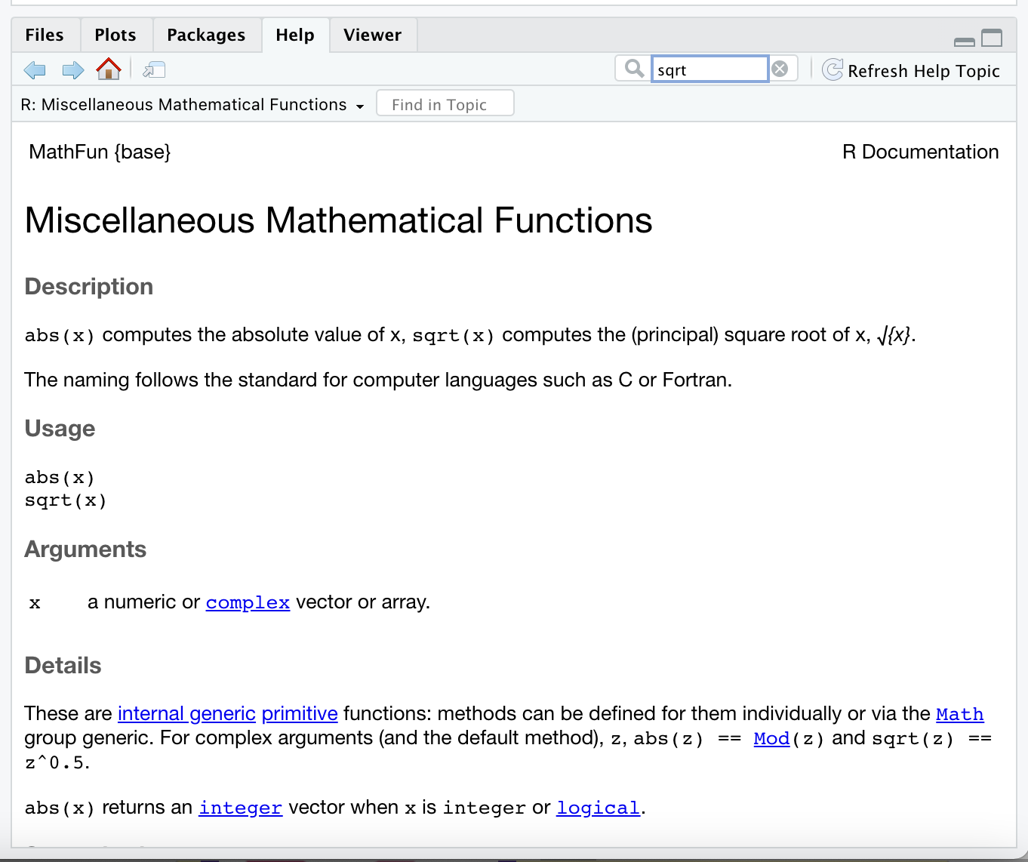
Help documentation

Slide 69
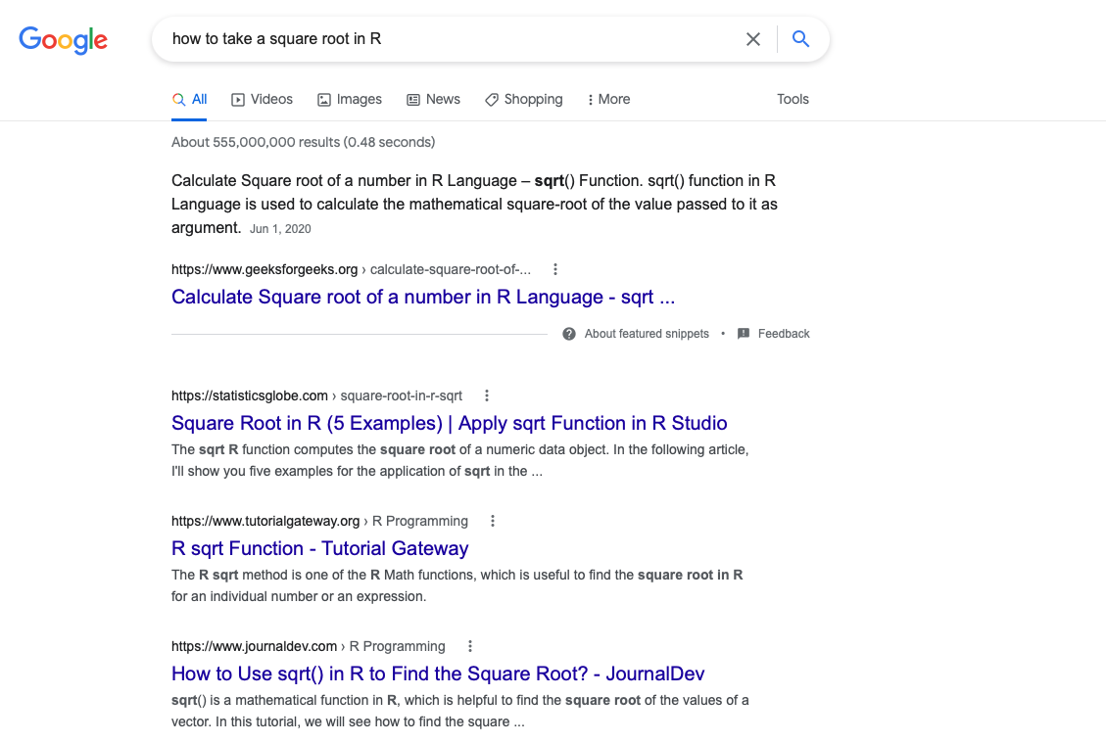
Google it!

Slide 70
Simple Variables
Numbers
Characters
Logicals

Slide 71
Creating variables
•
•
•
Variables are used to store information
They also provide a way of labelling information Use the “assignment operator” <- to create one

Slide 72
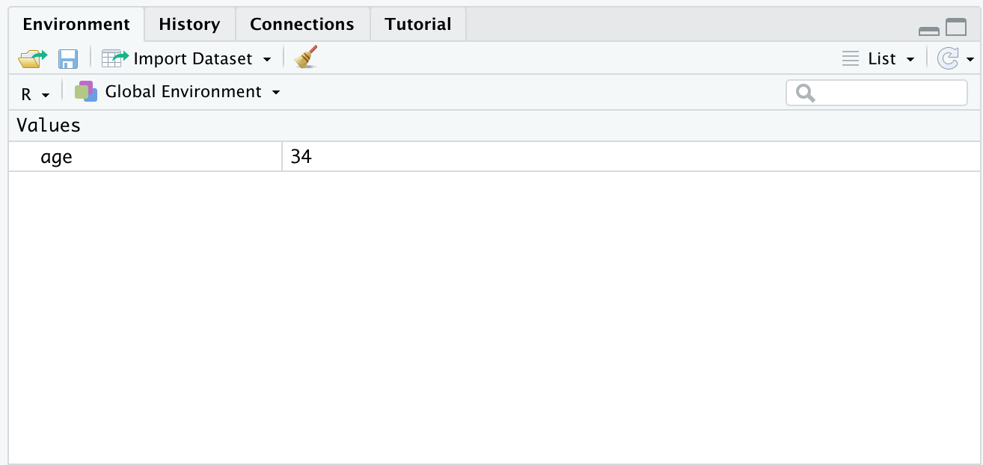
Creating variables
•
•
•
Variables are used to store information
They also provide a way of labelling information Use the “assignment operator” <- to create one
> age <- 34
No output appears in the console, but the variable shows up in the Rstudio “workspace” panel

Slide 73
Working with variables
>
> # this is a comment...
> # everything
>
(R ignores
after
the #)

Slide 74
Working with variables
>
> # this is a comment...
> # everything
>
>
(R ignores
after
the #)
age <- 34
# store the
value
34 as a variable,
called
"age"

Slide 75
Working with variables
>
> # this is a comment...
> # everything
>
>
>
(R ignores
after
the #)
age <- 34 print(age)
# store
# ask R
the value to
34 as
a variable,
called
"age"
print
it out...
[1] 34

Slide 76
Working with variables
>
> # this is a comment...
> # everything
>
>
>
(R ignores
after
the #)
age <- 34 print(age)
# store
# ask R
the value to
34 as
a variable,
called
"age"
it out...
you can just type
print
[1] 34
> age
# actually,
the name
directly...
[1] 34

Slide 77
Working with variables
>
> # this is a comment...
> # everything
>
>
>
(R ignores
after
the #)
age <- 34 print(age)
# store
# ask R
the value to
34 as
a variable,
called
"age"
it out...
you can just type
print
[1] 34
> age [1] 34
>
> age * 2 [1] 68
>
# actually,
the name
directly...
# R treats
"age"
the same
as the number 34:

Slide 78
Try it yourself:
Exercise 1.2.1: Introduction to Variables
Create a variable called year whose value corresponds to the year you were born
Print out the value of year by typing the variable name
Do it again using the print() function
Calculate the square root of year using the sqrt() function
Print out the value of year again to verify that the value of year hasn't changed
Reassign the value of year to year * 2
Print out the new value of year to verify that it has changed

Slide 79
There are different “classes” of variable
“Numeric” variables store numbers
>
> age <- 34
>

Slide 80
There are different “classes” of variable
>
> age <- 34
>
> name <- "dan"
>
“Character” variables store text.
The quote marks are used to tell R that this is text, and aren’t part of the data itself.

Slide 81
There are different “classes” of variable
>
> age <- 34
>
> name <- "dan"
>
> nerd <-
>
TRUE
“Logical” variables store truth values (i.e.,TRUE or FALSE).

Slide 82
There are different “classes” of variable
>
> age <- 34
>
> name <- "dan"
>
> nerd <-
>
Sometimes variables can have the “special” value of NA ... it means “missing data”, and it can be numeric, character or logical.
TRUE

Slide 83
Try it yourself:
Exercise 1.2.2: Variables of different types
You've already created a numeric variable: now try making a character (string) variable and a logical variable
Try creating (numeric) variables with “special” values: Inf (infinity), -Inf (minus infinity), NaN (“not a number”)
Try creating a variable with a “missing” value NA
Try creating a variable with a “non-existent” value NULL

Slide 84
Vectors

Slide 85
Vectors
•
Vectors are variables that store multiple pieces of information
•
•
Create vectors using c()
Extract specific elements using []

Slide 86
“Combining” elements using c()
c() combines a set of values, and stores them as a vector...
numeric vectors:
> age <- c( 34,2 )
> age
[1] 34 2

Slide 87
“Combining” elements using c()
c() combines a set of values, and stores them as a vector...
numeric vectors:
> age <- c( 34,2 )
> age
[1] 34 2
character vectors:
> name <- c( "dan", "alex" )
> name
[1] "dan" "alex"

Slide 88
“Combining” elements using c()
c() combines a set of values, and stores them as a vector...
numeric vectors:
> age <- c( 34,2 )
> age
[1] 34 2
character vectors:
> name <- c( "dan", "alex" )
> name
[1] "dan" "alex"
logical vectors:
> nerd <- c( TRUE, FALSE )
> nerd
[1] TRUE FALSE

Slide 89
You can give “names” to the elements:
> boredom <- c( time1 = 0.52, time2 = 0.82, time3 = 0.99 )
> boredom
time1 time2 time3 0.52 0.82 0.99

Slide 90
You can give “names” to the elements:
> boredom <- c( time1 = 0.52, time2 = 0.82, time3 = 0.99 )
> boredom
time1 time2 time3 0.52 0.82 0.99
> osx <- c( "10.7" = "Lion", "10.8" = "Mountain Lion", "10.9" = "Mavericks" )
> osx
10.7 10.8
10.9
"Mavericks"
"Lion" "Mountain Lion"

Slide 91
Try it yourself:
Exercise 1.2.3: Creating vectors
Create a numeric vector with three elements using c()
Create a character vector with three elements using c()
Create a numeric vector called age whose elements contain the ages of three people you know, where the names of each element correspond to the names of those people

Slide 92
Data Frames

Slide 93
Data frames
•
Data frames are the way R stores a typical data set
It is a collection of variables “bundled” together Organised into a “case by variable” matrix
Each row is a “case”
Each column is a named “variable”
•
•
•
•

Slide 94
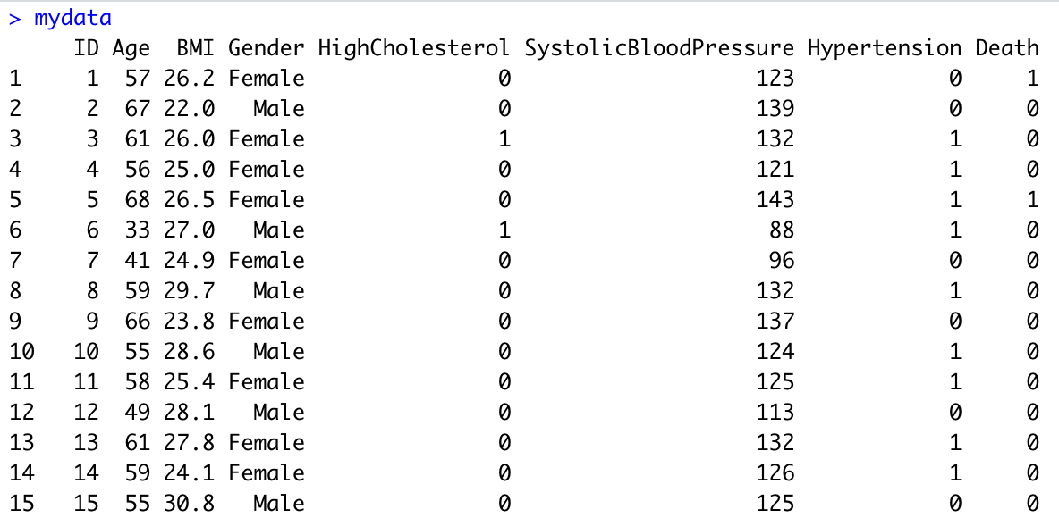
A data frame we’ll play with later!

Slide 95
A data frame we’ll play with later!
We’re showing the first 15 rows, of the dataset

Slide 96
It is a “bundle” of 8 vectors...

Slide 97
It is a “bundle” of 8 vectors...

Slide 98
They have a special relationship...
The 5th element of
each variable refers to the same person (“case”)

Slide 99
But they are still ordinary variables!

Slide 100
But they are still ordinary variables!
The command mydata$Age tells R
to look for a vector called Age that is stored in the data frame called mydata:
> mydata$Age

Slide 101
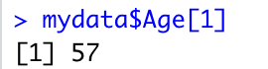
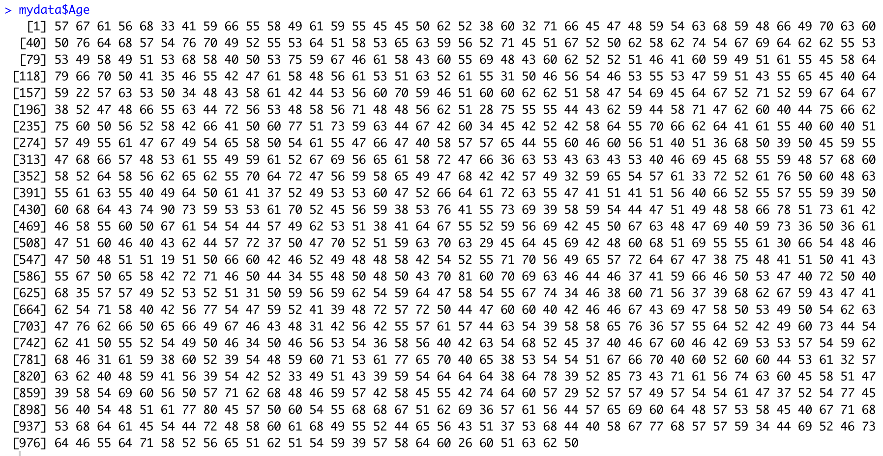
Variables inside data frames behave the same way as any other variable

Slide 102
Variables inside data frames behave the same way as any other variable

Slide 103
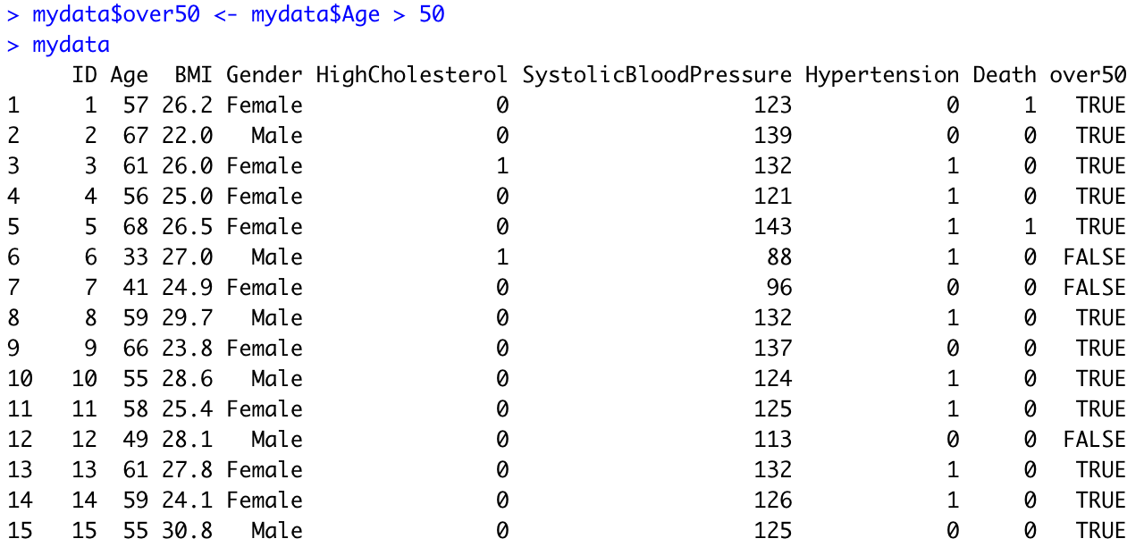
You can add variables to a data frame...
Use logical operator “>” to create a TRUE/FALSE variable called “over50” based on Age in mydata to indicate whether each person in the data frame is older than 50 or not

Slide 104
You can add variables to a data frame...

Slide 105
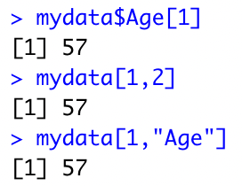
Indexing elements in a data frame?
mydata$Age is a vector, and we’re requesting the 1st element of it

Slide 106
Indexing elements in a data frame?
mydata$Age is a vector, and we’re requesting the 1st element of it
mydata is a data frame, and we’re requesting the value found in the 1st row, and the 2nd column

Slide 107
Indexing elements in a data frame?
mydata$Age is a vector, and we’re requesting the 1st element of it
mydata is a data frame, and we’re requesting the value found in the 1st row, and the 2nd column
mydata is a data frame, and we’re requesting the value found in the 1st row, and the column named “Age”

Slide 108
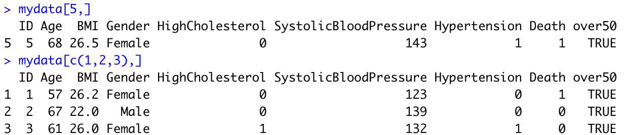
You can also pull out individual rows...

Slide 109
You can also pull out individual rows...

Slide 110
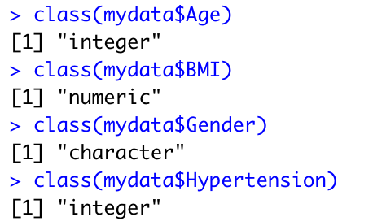
Let’s explore our variables using “class” function
Recall the different variable “classes”

Slide 111
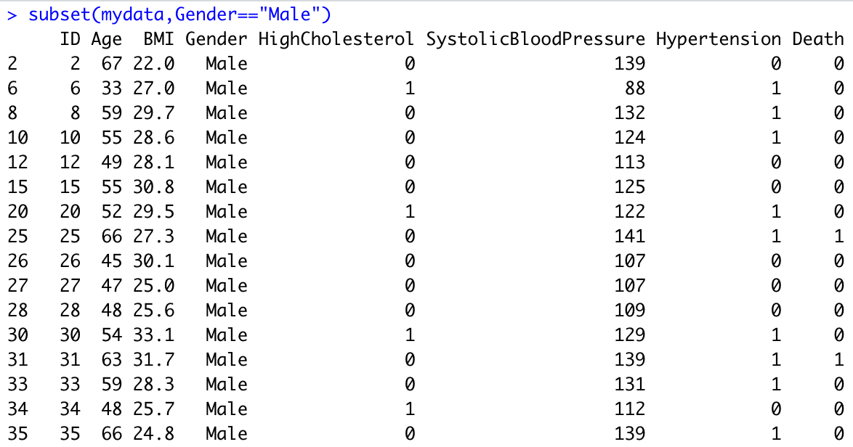
Use “subset” function
Pull out all cases that satisfy some criterion?

Slide 112
Use “subset” function
Pull out all cases that satisfy some criterion?
Since Gender is a character variable, need to use quotes

Slide 113
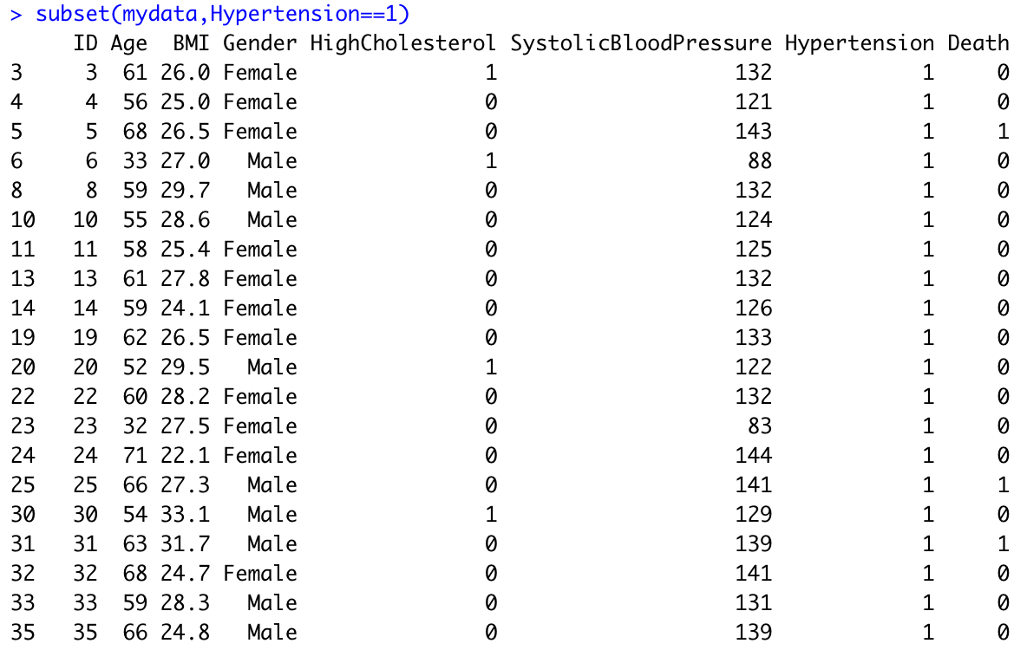
Use “subset” function
Pull out all cases that satisfy some criterion?

Slide 114
Use “subset” function
Pull out all cases that satisfy some criterion?
Since hypertension is an integer variable, don’t need to use quotes

Slide 115
Importing data from text files (CSV)
Want to load in “mydata” to RStudio?

Slide 116
To read it in:
For iOS
read.csv("/Users/mkca/Downloads/mydata.csv", header = TRUE)
For Windows
read.csv("C:\\Users\\mkca\\Downloads\\mydata.csv”, header = TRUE)
For iOS
mydata <- read.csv("/Users/mkca/Downloads/mydata.csv", header = TRUE)
For Windows
mydata <- read.csv("C:\\Users\\mkca\\Downloads\\mydata.csv”, header = TRUE)
To read it in and save it as “mydata”
header = TRUE means we tell R to take the first row of the .csv file and let it be our variable names
Note: We can also use header=T which is synonymous with header=TRUE

Slide 117
Try it yourself:
Exercise 1.2.4: Data Frames
Use the read.csv() function to load in the mydata.csv file and save it as a file called “mydata”
Hint: mydata<-read.csv("/Users/Lily1/Documents/mydata.csv", header=T)
Make sure you have the correct path!
Use the $ method to print out the BMI variable in mydata
Print out the third element of the BMI variable
Print out the tenth row found in the column called “Hypertension”
Use logical indexing to create a new variable called “Underweight,” which is TRUE if BMI in mydata is less than 18.5 and FALSE otherwise
Use the class function to see what types of variables Gender and SystolicBloodPressure are
Use the subset function to subset the data to only individuals with high cholesterol (HighCholesterol==1)

Slide 118

The R “Environment”

Slide 119
The environment
•
The R “environment” consists of all of the variables that you have loaded or defined
•
•
•
e.g. age, BMI, etc
These are all variables in the workspace
R holds them in memory; you can save them to disk if you want to (see later)

Slide 120
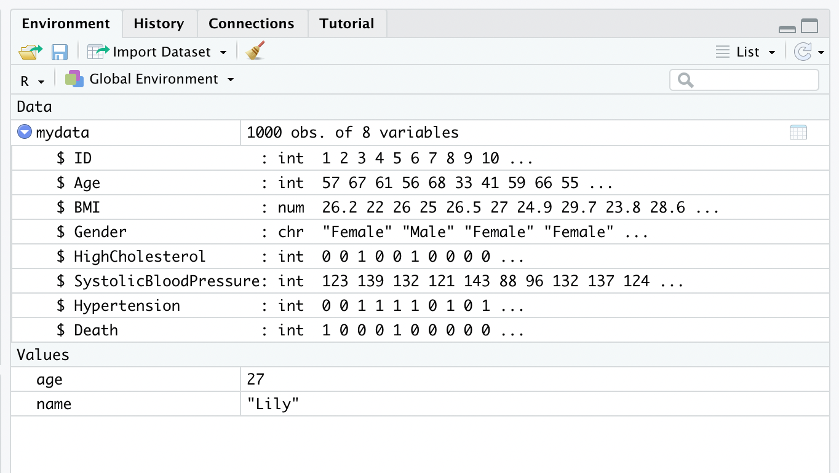
Rstudio gives some summary information about the environment

Slide 121
Rstudio gives some summary information about the environment
Shows we have data frame mydata with 1000 observations (people) and 8 variables

Slide 122
Rstudio gives some summary information about the environment
Shows that BMI inside the data frame mydata numeric

Slide 123
(R commands to do the same thing)
> class(mydata$BMI) [1] "numeric"

Slide 124
Delete everything from the environment?
Click here (you will be asked to confirm before deletion occurs)

Slide 125
Deleting just one variable using NULL
before...
NULL is a special “value” in R that means “this variable does not exist” or “it has no value”. It is different to NA, which means “the variable exists (and in principle has a value), but that value is missing/unknown”
> mydata$BMI<-NULL

Slide 126
Deleting just one variable using NULL
before...
NULL is a special “value” in R that means “this variable does not exist” or “it has no value”. It is different to NA, which means “the variable exists (and in principle has a value), but that value is missing/unknown”
> mydata$BMI<-NULL

Slide 127
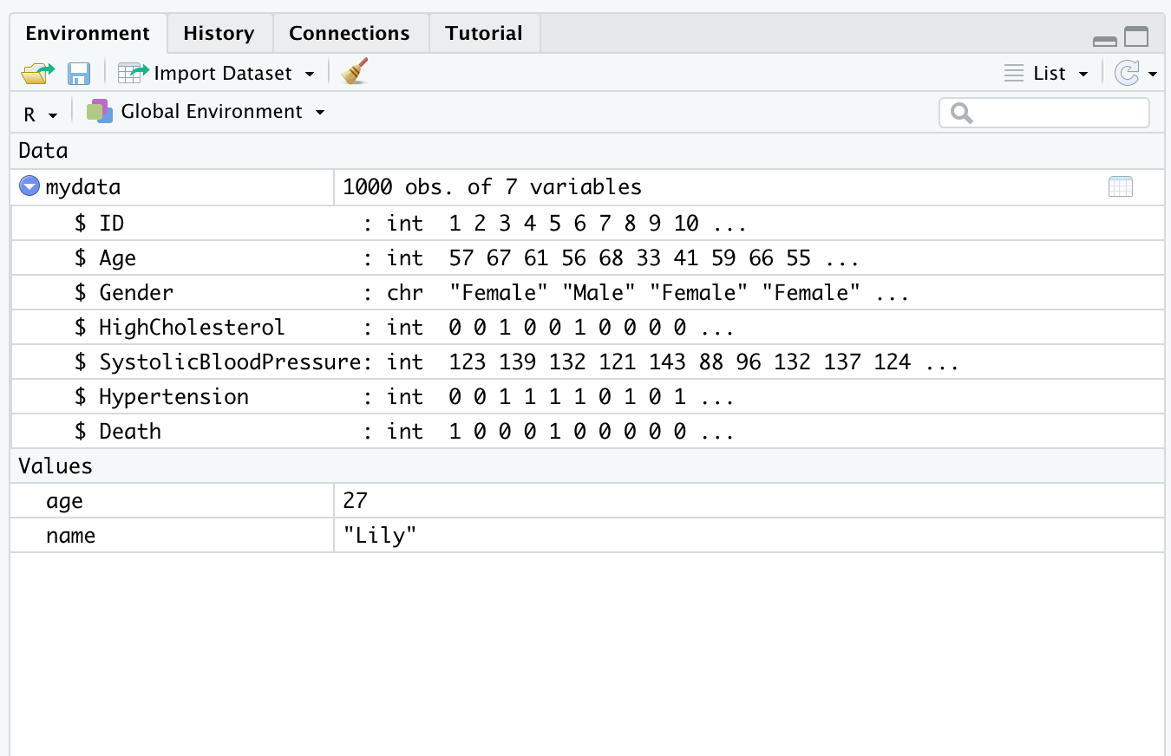
Deleting just one variable using NULL
after...

Slide 128
We might have variables in the environment, but not in a data frame

Slide 129
We might have variables in the environment, but not in a data frame
before...
Can remove a single variable from the environment (if not in data frame) using rm() function
> rm(age)

Slide 130
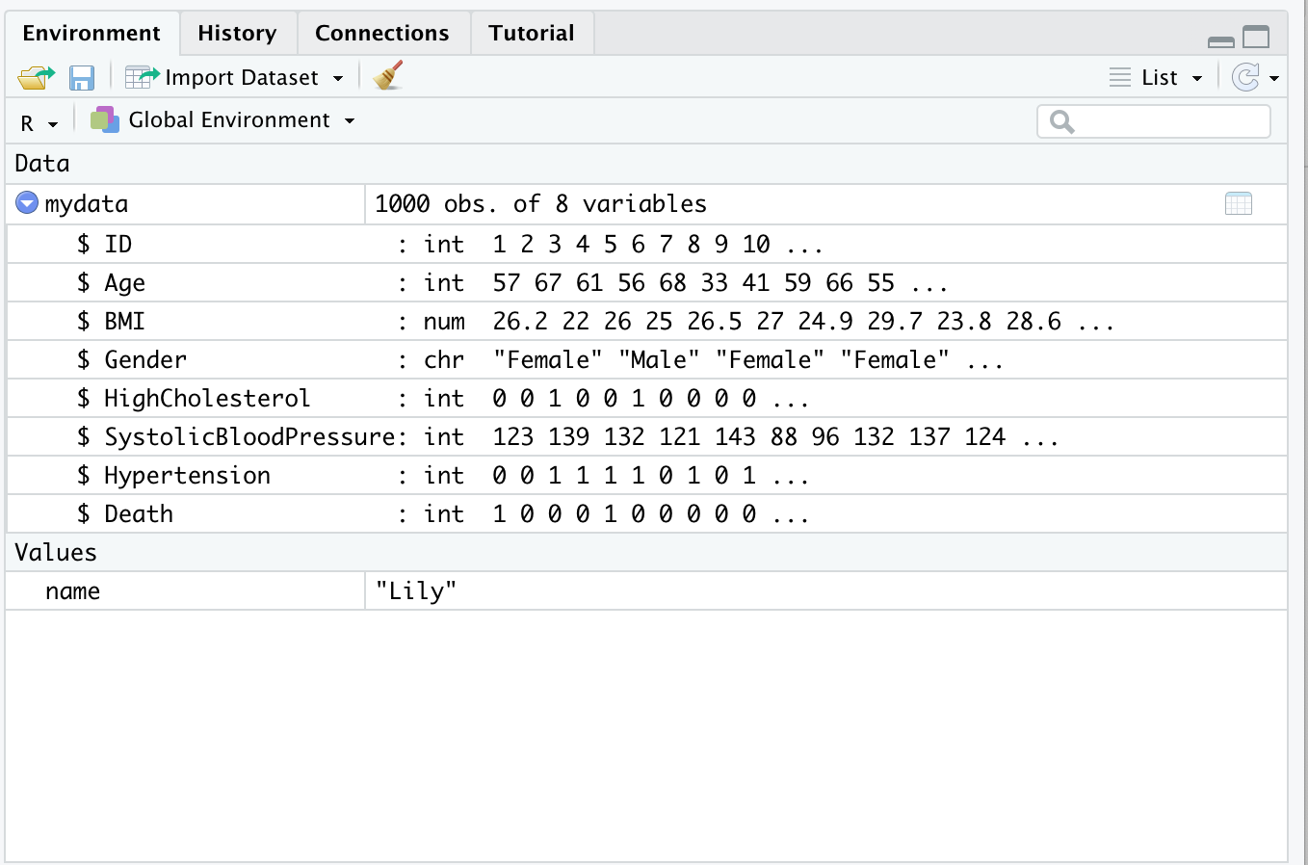
Delete a single variable using rm() function
after…

Slide 131
Try it yourself:
Exercise 1.2.5: Understanding the environment and removing variables
Clear the environment using RStudio's “clear objects from the environment” button
Delete the variable Death from mydata using the <- NULL approach
Try to print out the variable you just removed (mydata$Death) to see what happens!
Create a character variable called color (not inside mydata, just in R environment) that represents your favorite color and then remove it using rm()

Slide 132
Thank You!
Questions?

Slide 133
References
Introduction to Biostatistics, Larry Winner, Department of Statistics University of Florida
Introduction to Biostatistics, Jonggyu Baek, University of Massachusetts Medical School
Introduction to Biostatistics, University of Georgia
Introduction to Biostatistics for Clinical and Translational Researchers, KUMC Departments of Biostatistics & Internal Medicine, University of Kansas Cancer Center
Introduction to R, Dan Navarro (daniel.navarro@adelaide.edu.au) School of Psychology, University of Adelaide, ua.edu.au/ccs/people/dan CSIRO R Workshop, 28-Nov-2013
Introduction to Biostatistics & R 2022, Lillian Boe, University of Pennsylvania

